Slide 1
EF Core - MySQL
Manuel kommenda

Slide 2
Dependencies
Install-Package MySql.EntityFrameworkCore -Version 5.0.0-m8.0.23
Install-Package MySql.EntityFrameworkCore -Version 3.1.10-m8.0.23
Nuget packagemanager
MySql.Data.EntityFrameworkCore

Slide 3
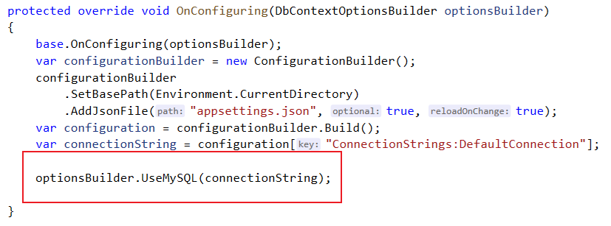
Db-Context
"ConnectionStrings": {
"DefaultConnection": "server=localhost; port=3306; database=devices; user=root; password=root; Persist Security Info=False; Connect Timeout=300"
}

Slide 4
DataAnnotations
using MySql.EntityFrameworkCore.DataAnnotations;
[MySqlCharset("utf8")]
public class ComplexKey
{
[MySqlCharset("latin1")
public string Key1 { get; set; }
[MySqlCharset("latin1")]
public string Key2 { get; set; }
[MySqlCollation("latin1_spanish_ci")]
public string CollationColumn { get; set; }
}

Slide 5
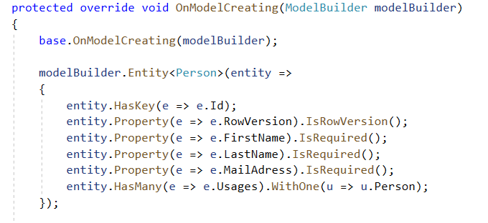
Fluent API

Slide 6
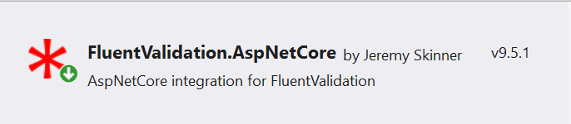
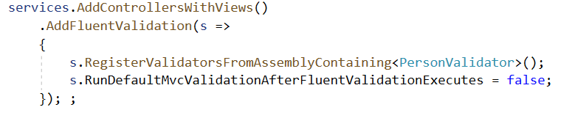
Fluent Validation

Slide 7
Demo

